Slide 1

Building an Effective Project Team

Slide 2
Lecture6 Outline
The effective team
  Personality types, Discover your personality type, learn how to motivate the personality in your team.
Student: Read L6 the effective team & prepare for a quiz.
Independent study: Read the next slide for the next lecture.

Slide 3
Coming up
Different Personality Types
  Belbin, MBTI, TMS
  Strengths & Weaknesses
  How To Notice Them In Your Project
Discover Your Personality Type
Learn How To Motivate The Personalities In Your Team

Slide 4
Belbin’s Ideal Team
PLANT
RESOURCE INVESTIGATOR
CO-ORDINATOR
SHAPER
MONITOR EVALUATOR
TEAM WORKER
IMPLEMENTER
COMPLETER-FINISHER
SPECIALIST

Slide 5
Myers-Briggs - MBTI
Psychological Teaching of Carl Gustav Jung
Most wildly used over 35 years
Based on 4 Scales, having 16 combinations

Slide 6
Scales
E-I | Extroversion - Introversion
S-N | Sensing - iNtuition
T-F | Thinking – Feeling
J-P | Judging - Perceiving

Slide 7
The Eight Preferences
(E)xtraversion
Focus on outer world of people, many friends with brief contact, Talk more than listen, Approachable, keep up with social happenings.
(I)ntroversion
Focus on inner world of ideas. Few friends with longer contact, Good listeners, reserved, reflective, private.
(S)ensing
Focus on the present, like tangible results, facts and figures, Sequential--Front to back, literal, down to earth, specific answers, routines.
i(N)tuition
Focus on the future or past, patterns & possibilities, ideas and theories, head in the clouds, like general answers, fantasies and daydreaming.
(T)hinking
Decisions based on logic and objective analysis, remember numbers & figures better than names & faces, prefer truth over agreement.
(F)eeling
Decisions based on personal feelings and values, think with the heart, compassionate, puts self in others' shoes, prefer harmony over truth.
(J)udging
Likes to-do lists and schedules, organized, neat, do what you're supposed to do, deadlines, order, get things done, work first, always on time.
(P)ercieving
Flexible, spontaneous, adaptable, doesn't plan, like the unknown, easily distracted, wait till last minute, turns work into play, keep options open

Slide 8
Type
% of
Pop
Dominant
Function
Auxiliary
Function
Title(s)
Unique Ability
INTP
1%
T-in
N-out
Architect, Abstractionist
Logical
INTJ
1%
N-in
T-out
Scientist, Builder
Independent
ENTP
5%
N-out
T-in
Inventor, Iconoclast
Inventive
ENTJ
5%
T-out
N-in
Fieldmarshal, Commandant
Commandeering
INFP
1%
F-in
N-out
Questor, Crusader / Monastic
Non-directive
INFJ
1%
N-in
F-out
Author, Oracle
Empathic
ENFP
5%
N-out
F-in
Journalist, Herald
Optimistic
ENFJ
5%
F-out
N-in
Pedagogue, Catalyst, Teacher
Persuasive
ESFP
13%
S-out
F-in
Entertainer, "Life of the Party"
Generous
ESTP
13%
S-out
T-in
Promoter, Resourceful
Unpredictable
ISFP
6%
F-in
S-out
Flower Child, Disestablishmentarian
Artistic
ISTP
6%
T-in
S-out
Artisan
Skillful with tools
ESFJ
13%
F-out
S-in
Seller, "Master of Ceremonies"
Harmonizing
ESTJ
13%
T-out
S-in
Administrator, Responsible
Hard-charging
ISFJ
6%
S-in
F-out
Conservator
Loyal
ISTJ
6%
S-in
T-out
Trustee, Dependable
Strong and silent

Slide 9
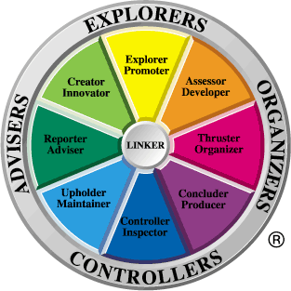
TMS Profile
Creative
Extrovert
8 Roles
16 Sub-sectors
Reliable
Valid
Backed by research
Flexible
Analytical
Belief
Structured
Team Management Systems 1999©
Introvert
Practical

Slide 10
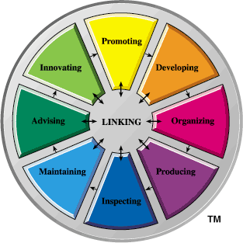
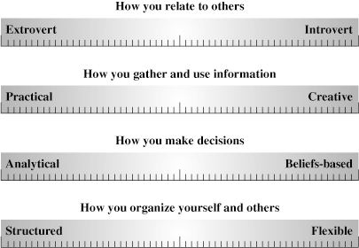
- Model of Work
+
- Model of People
=
- Model of People
@ Work

Slide 11
Personality Types
The life so short, the craft so long to learn – Hippocrates 5th cent. B.C.
Loud & late, optimistic – Sanguines
  Blood “energy & optimism”
Leaders of the pack, bossiness – Cholerics
  Yellow Bile “control & anger”
Life in order, moody – Melancholies
  Black Bile “intelligence, tendency to depression”
Easy going, watchers – Phlegmatics
  Phlegm “peaceful & passive”

Slide 12
Personality Profile
SANGUINE
CHOLERIC
OUTGOING
STRONG-WILLED
RESPONSIVE
INDEPENDENT
COLD &
UNEMOTIONAL
VISIONARY
WARM & FRIENDLY
UNDISCIPLINED
TALKATIVE
EMOTIONALLY
UNSTABLE
SELF-SUFFICIENT
PRACTICAL
IMPETUOUS
PRODUCTIVE
ENTHUSIASTIC
UNPRODUCTIVE
DOMINEERING
UNFORGIVING
DECISIVE
EGOCENTRIC
SARCASTIC
COMPASSIONATE
EXTRAVERTED
LEADER
EXAGGERATES
CRUEL
ANGRY
Tasks
Relationships
CALM, QUIET
UNMOTIVATED
MOODY
GIFTED
PROCRASTINATOR
INTROVERTED
SELF-CENTRED
DEPENDABLE
SELFISH
PERSECUTION-PRONE
ANALYTICAL
EASYGOING
STINGY
REVENGEFUL
AESTHETIC
OBJECTIVE
SELF-PROTECTIVE
TOUCHY
THEORETICAL
SELF-SACRIFICING
DIPLOMATIC
INDECISIVE
FEARFUL
UNSOCIABLE
INDUSTRIOUS
EFFICIENT, ORGANIZED
CRITICAL
WORRIER
NEGATIVE
SELF-DISCIPLINED
PRACTICAL, HUMOUROUS
MELANCHOLY
PHLEGMATIC

Slide 13
Personality Profile
CHOLERIC
SANGUINE
The Leader
The Fun Lover
No Frills
Bright Clothes
Grand Gestures
On A Mission
Speak 1st Think Later
Strong Gestures
Takes In The Mood
Very well Organized
Gentle Spirit
Perfect Posture
Casual
Diaries
The Perfectionists
Easy Does It!
MELANCHOLY
PHLEGMATIC
HOW TO KNOW THEM

Slide 14
Personality Profile
CHOLERIC
SANGUINE
Sales
Leader
Actor
Controller
Preacher
Cause Fighter
Inventor
Primary Teacher
Artist
Local Government
Professional
Diplomat
MELANCHOLY
PHLEGMATIC
Jobs They SHOULD Do

Slide 15
Personality Profile
CHOLERIC
SANGUINE
Doctor
Counselor
Pilot
Primary Teacher
Motivational Speaker
Co-Pilot
Car Salesman
Army Officer
Jobs They Should NEVER Do
MELANCHOLY
PHLEGMATIC

Slide 16
Personality Profile
SANGUINE
CHOLERIC
OUTGOING
STRONG-WILLED
RESPONSIVE
INDEPENDENT
COLD &
UNEMOTIONAL
VISIONARY
WARM & FRIENDLY
UNDISCIPLINED
TALKATIVE
EMOTIONALLY
UNSTABLE
SELF-SUFFICIENT
PRACTICAL
IMPETUOUS
PRODUCTIVE
ENTHUSIASTIC
UNPRODUCTIVE
DOMINEERING
UNFORGIVING
DECISIVE
EGOCENTRIC
SARCASTIC
COMPASSIONATE
EXTRAVERTED
LEADER
EXAGGERATES
CRUEL
ANGRY
Tasks
Relationships
CALM, QUIET
UNMOTIVATED
MOODY
GIFTED
PROCRASTINATOR
INTROVERTED
SELF-CENTRED
DEPENDABLE
SELFISH
PERSECUTION-PRONE
ANALYTICAL
EASYGOING
STINGY
REVENGEFUL
AESTHETIC
OBJECTIVE
SELF-PROTECTIVE
TOUCHY
THEORETICAL
SELF-SACRIFICING
DIPLOMATIC
INDECISIVE
FEARFUL
UNSOCIABLE
INDUSTRIOUS
EFFICIENT, ORGANIZED
CRITICAL
WORRIER
NEGATIVE
SELF-DISCIPLINED
PRACTICAL, HUMOUROUS
MELANCHOLY
PHLEGMATIC
Opposites Attract!

Slide 17
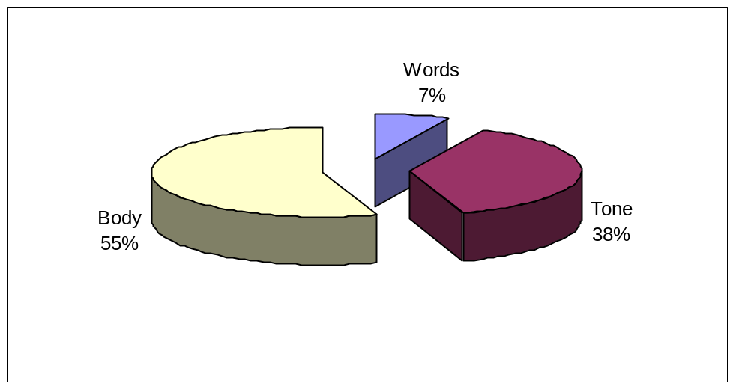
Nonverbal Communication
Nonverbal communication includes:
  vocal intonation
  body language
  gestures
  physical distance
  facial expressions
  touch

Slide 18
People Like People
Who Are Like Themselves
&
People Like People
They’d Like To Be Like
Communication LAW

Slide 19
Are You Ready To Sit The Personality Test?

Slide 20
Personality Profile
SANGUINE
CHOLERIC
OUTGOING
STRONG-WILLED
RESPONSIVE
INDEPENDENT
WARM & FRIENDLY
VISIONARY
TALKATIVE
PRACTICAL
PRODUCTIVE
ENTHUSIASTIC
DECISIVE
COMPASSIONATE
LEADER
CALM, QUIET
GIFTED
DEPENDABLE
ANALYTICAL
EASYGOING
AESTHETIC
OBJECTIVE
SELF-SACRIFICING
DIPLOMATIC
INDUSTRIOUS
EFFICIENT, ORGANIZED
SELF-DISCIPLINED
PRACTICAL, HUMOUROUS
MELANCHOLY
PHLEGMATIC

Slide 21
Personality Profile
SANGUINE
CHOLERIC
OUTGOING
STRONG-WILLED
RESPONSIVE
INDEPENDENT
WARM & FRIENDLY
VISIONARY
TALKATIVE
PRACTICAL
PRODUCTIVE
ENTHUSIASTIC
DECISIVE
COMPASSIONATE
LEADER
CALM, QUIET
GIFTED
DEPENDABLE
ANALYTICAL
EASYGOING
AESTHETIC
OBJECTIVE
SELF-SACRIFICING
DIPLOMATIC
INDUSTRIOUS
EFFICIENT, ORGANIZED
SELF-DISCIPLINED
PRACTICAL, HUMOUROUS
MELANCHOLY
PHLEGMATIC

Slide 22
Choleric
What Doesn’t Work?
‘On The Fence’ Ideas & Concepts
Too Much Time on One Issue
Unprepared
Lack of Focus
Not being In Control

Slide 23
Choleric
What Works?
Support & Understand their Goals
Get to the Point
Simple Outlines
Businesslike
Task Oriented

Slide 24
Phlegmatic
What Doesn’t Work?
Being Too Intense or Overly Formal
Not Recognising ‘People’ Aspect
Forcing Decisions
Ignoring Feelings
Threatening

Slide 25
Phlegmatic
What Works?
Casual & Sincere approach
Slow Down & Listen
Make Honesty Safe
Set Goals
Build them up

Slide 26
Melancholic
What Doesn’t Work?
Lack of Attention to Details
Inconsistency
Disorganisation
Overly emotional Approach

Slide 27
Melancholic
What Works?
Charts, Graphs & Figures
Facts, Logic & Structure
Step-By-Step Approach
Attention to Detail
Appointments

Slide 28
Sanguine
What Doesn’t Work?
Following the Rules Blindly
Being Ignore
Rigid Thinking
Too Many Details
Lack of Challenge

Slide 29
Sanguine
What Works?
Praise, Attention & Recognition
Flexibility
Idealistic Concepts
Let them Talk
Enthusiasm

